Slide 1


Slide 2
BIRCH stands for Balanced Iterative Reducing and Clustering Using Hierarchies, which uses hierarchical methods to cluster and reduce data.
BIRCH only needs to scan the data set in a single pass to perform clustering.
How does it work?
The BIRCH algorithm uses a tree structure to create a cluster. It is generally called the Clustering Feature Tree (CF Tree). Each node of this tree is composed of several Clustering features (CF).

Slide 3
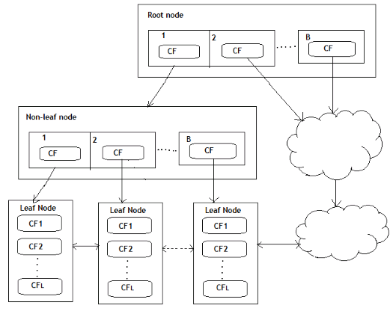

Slide 4
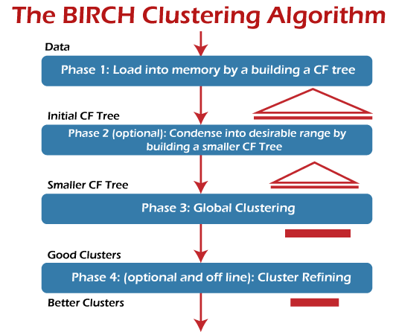

Slide 5
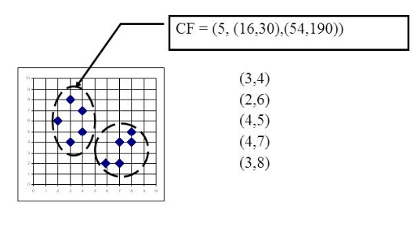

Slide 6
